Slide 1


EDA Project
AMCAT Data Analysis
By :
Madhavi . N

Slide 2




About me :
Background ? (B-tech or M-tech) : Madhavi ( BSc(COMPUTERS)), Data Science Course
Why you want to learn Data Science : For FUTURE GROWTH, To get better CAREER OPPORTUNITIES
Any work experience : No
Share your LinkedIn and GitHub profile URLs :
Note : Links are available in hyperlink to above logos

Slide 3
AMCAT stands for Aspiring Minds from the Aspiring Mind Employment Outcome
Problem Statement : -
Perform Exploratory Data Analysis (EDA) on the data-set 'data.xlsx', while considering Salary as a target variable. And, write a minimum of 5 Page report in a Ppt file or Word document.
Data Description : -
The given dataset i.e., 'data.xlsx' was released by Aspiring Minds from the Aspiring Mind Employment Outcome 2015 (AMEO).
It contains the employment outcomes of engineering graduates as dependent variables (Salary, Job Titles, and Job Locations) along with the standardized scores from three different areas – cognitive skills, technical skills and personality skills.
It also contains demographic features and a unique identifier for each candidate.
It contains nearly 40 independent variables and 4000 data points.
The independent variables are both continuous and categorical in nature.

Slide 4
Objective of the Project : -
This analysis aims to gain insights and understanding from the provided dataset, particularly focusing on the relationship between various features and the target variable, which is Salary.
Specifically, the goals of this analysis include:
• Describing the dataset and its features comprehensively.
• Identifying any patterns or trends present in the data.
• Exploring the relationships between independent and target variables (Salary).
• Identifying any outliers or anomalies in the data.

Slide 5
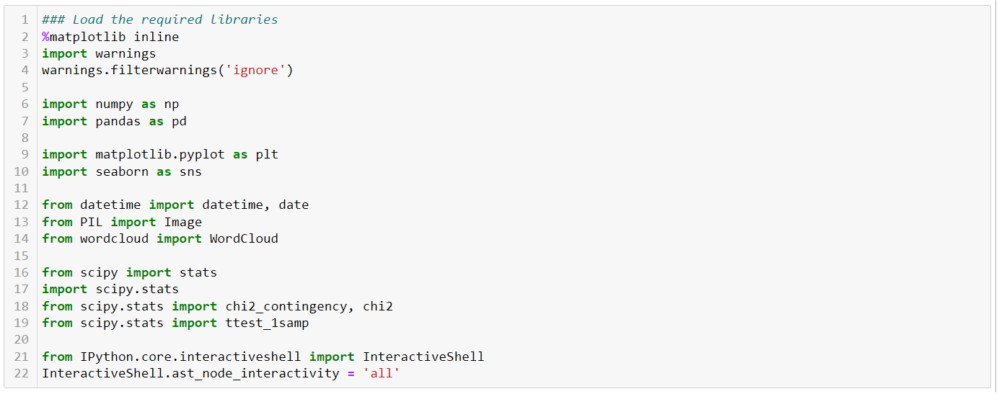
Step – 1 : -
We have to import all required libraries for Analysis .

Slide 6
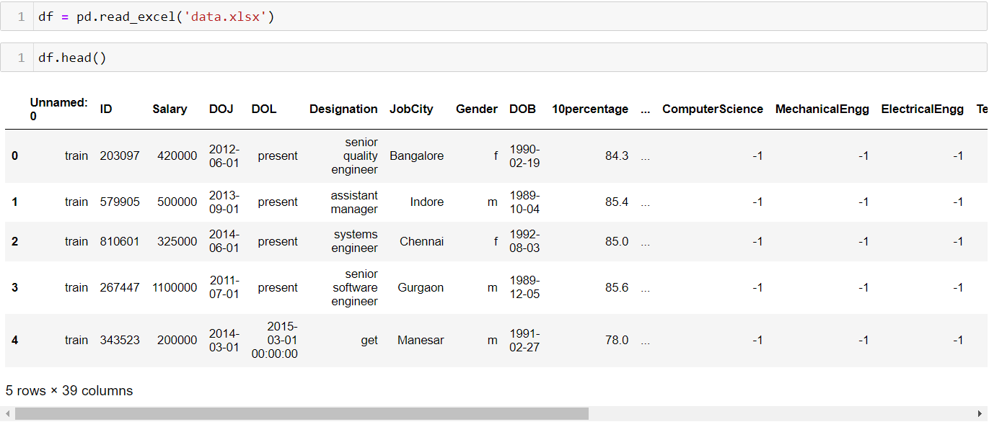
Importing the data into a dataframe and displaying the head, shape, descriptions and info .

Slide 7
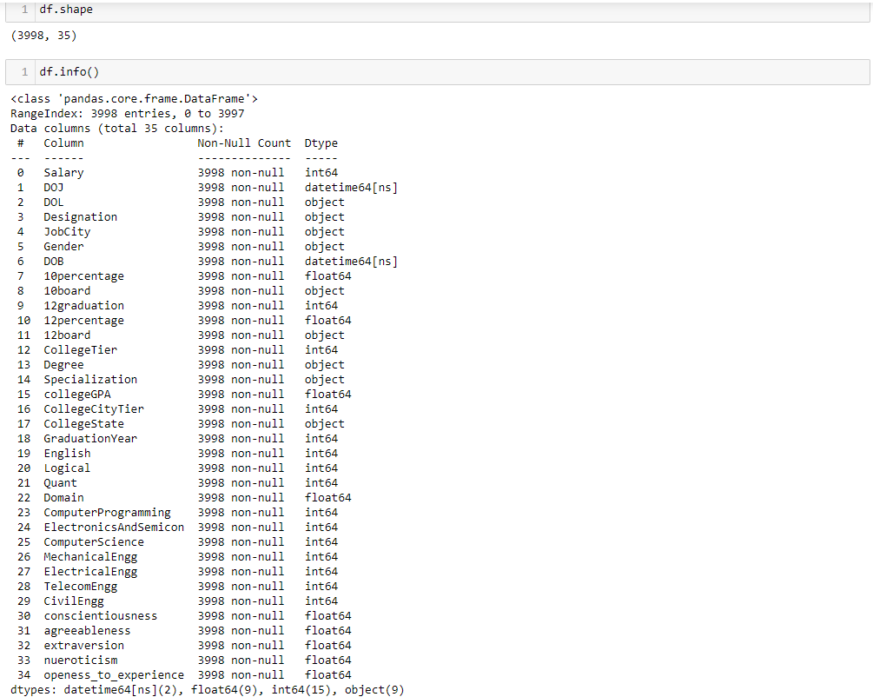

Slide 8
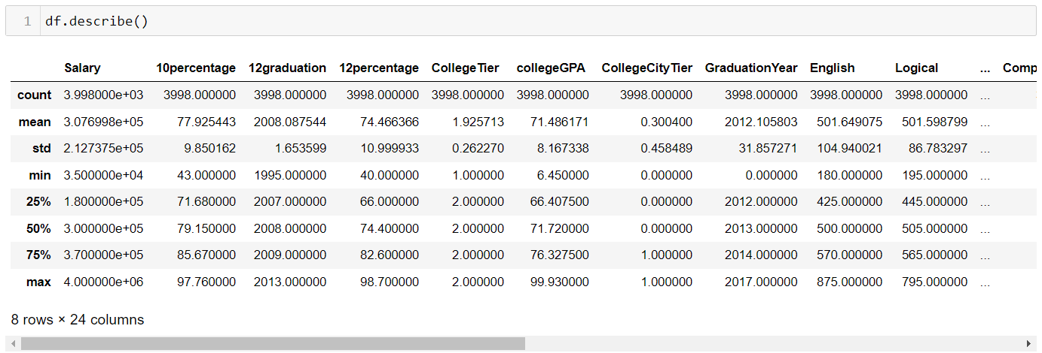

Slide 9
Exploratory Data Analysis

Slide 10
- : Data Cleaning Steps : -
Removing duplicates.
Remove irrelevant data.
Standardize capitalization.
Convert data type.
Handling outliers.
Fix errors.
Dealing with the missing values(NAN values).

Slide 11
- : Before Cleaning Data : -

Slide 12
- : Data Manipulation Steps : -
Create a database from different data sources.
Cleanse, rearrange, and restructure data.
Combine, merge, and remove information based on requirements.
Acquire insights by conducting data analysis and use the derived information to make better business decisions.

Slide 13
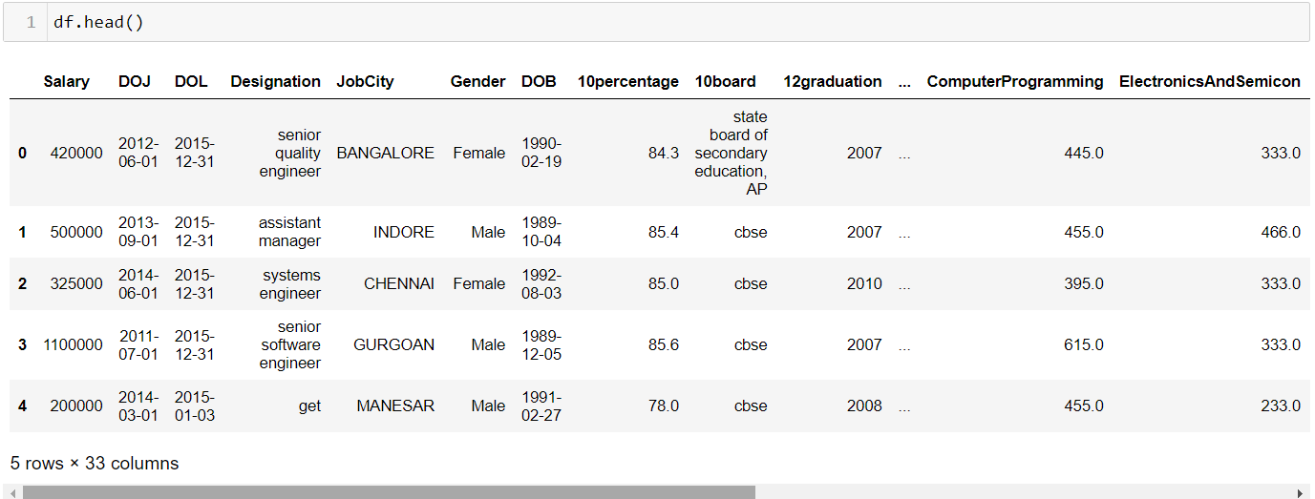
- : After Cleaning Data : -

Slide 14
Plots for AMCAT Data Analysis

Slide 15
- : Univariate Analysis Steps : -
Accessing the dataset.
Identifying the variable that needs to be analyzed.
To Analyze One Variable.
Find patterns.

Slide 16
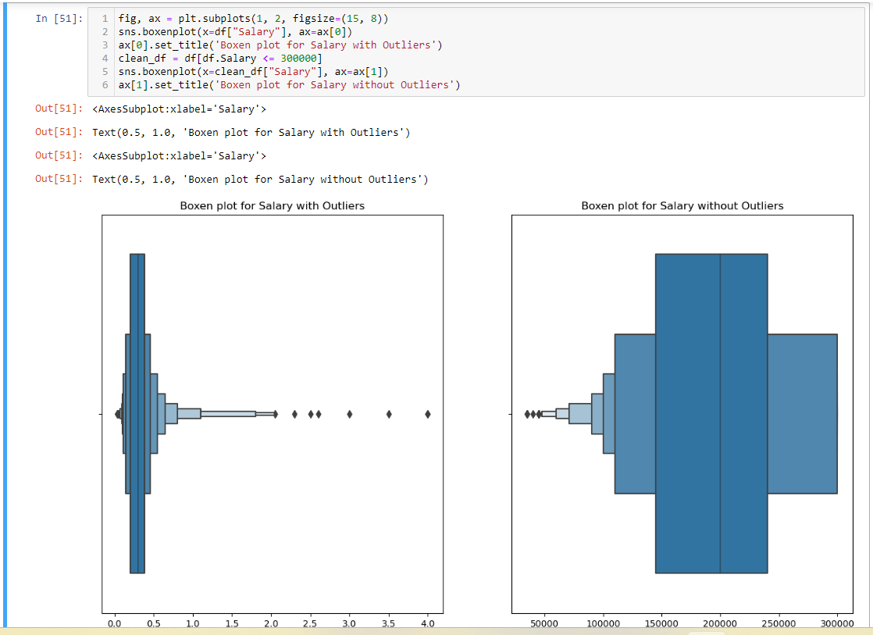
Observation : In the Boxen plot of candidates salaries, we observed that more of boxen was at right side which has lower salaries . It indicates that a majority of candidates earn salaries on the lower end. We plot 2 plots for with outliers and without outliers.

Slide 17
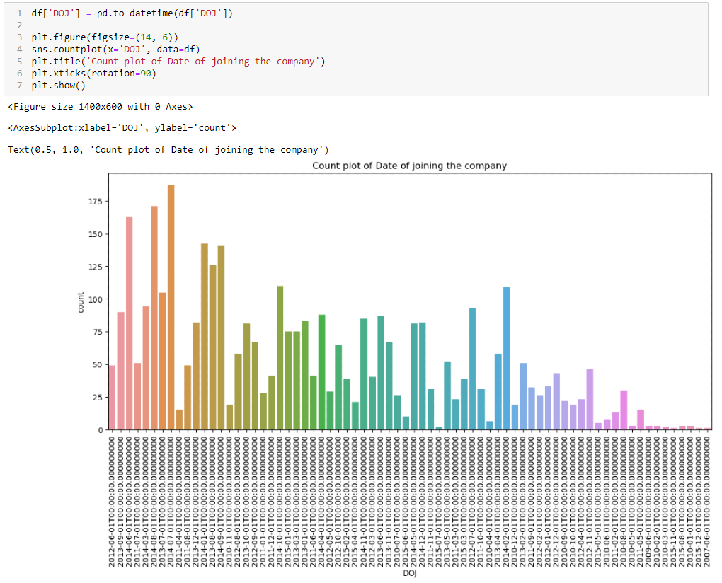
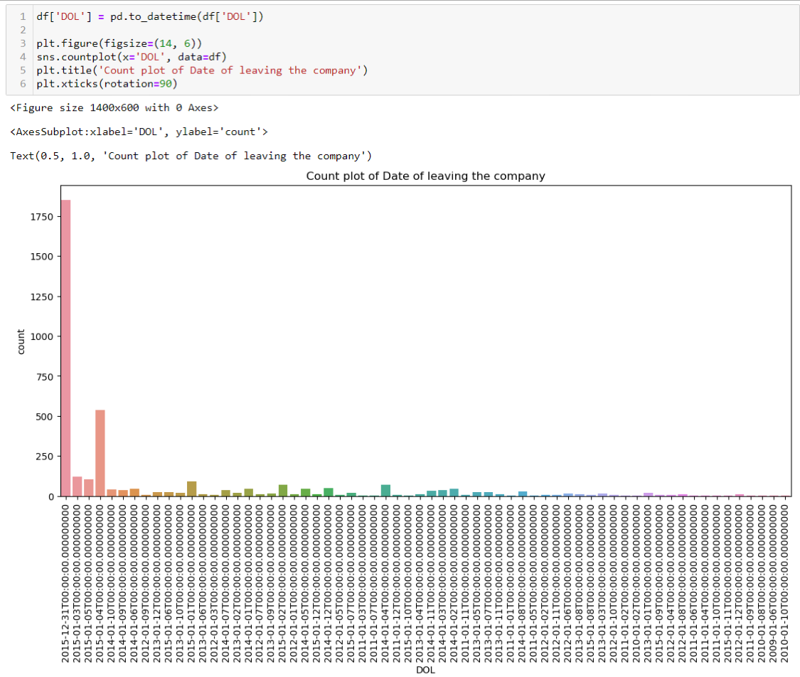
Observation : In the Count plot of candidates DOJ & DOL, we observed that a lot of candidates joined in 2014, 2013 respectively and a more of candidates left in 2015.

Slide 18
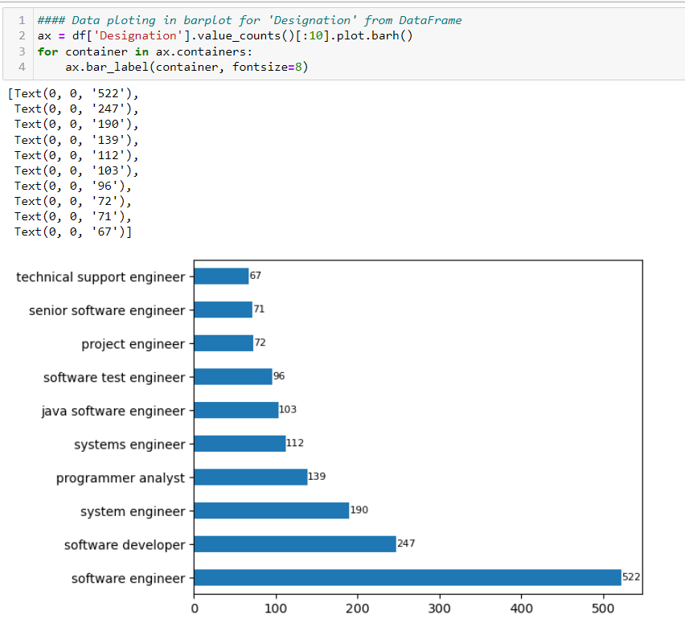
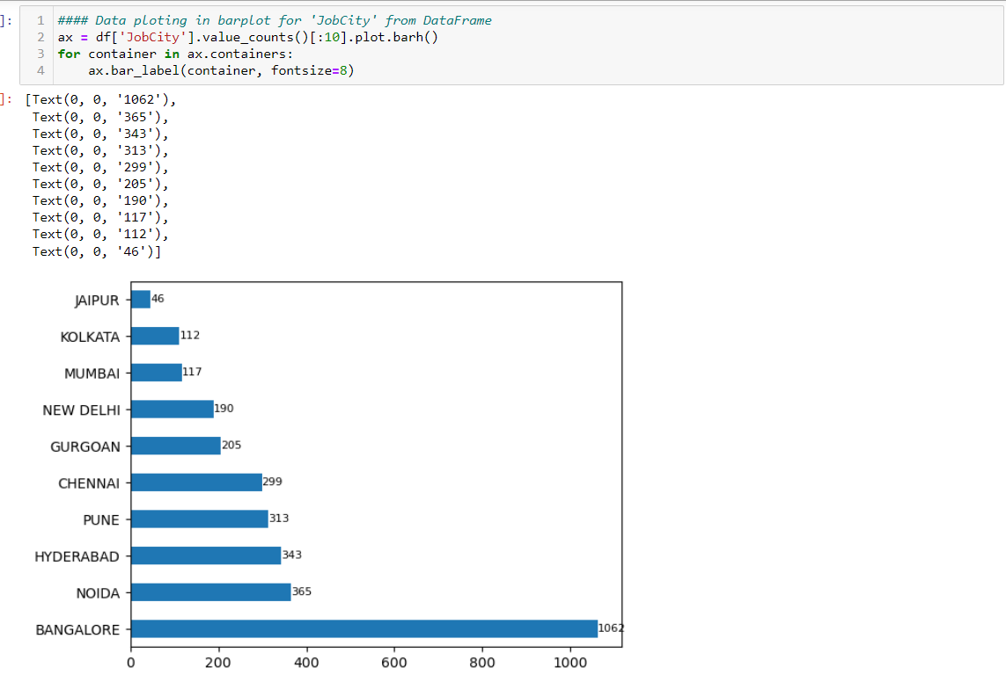
Observation : In the horizontal bar plot of candidates Designations, we observed that Software Engineer , Software Developer and System Engineer earn more respectively.
Observation : In the horizontal bar plot of candidates Job City, we observed that Bangalore, Noida and Hyderabad are most often cities with candidates jobs respectively.

Slide 19
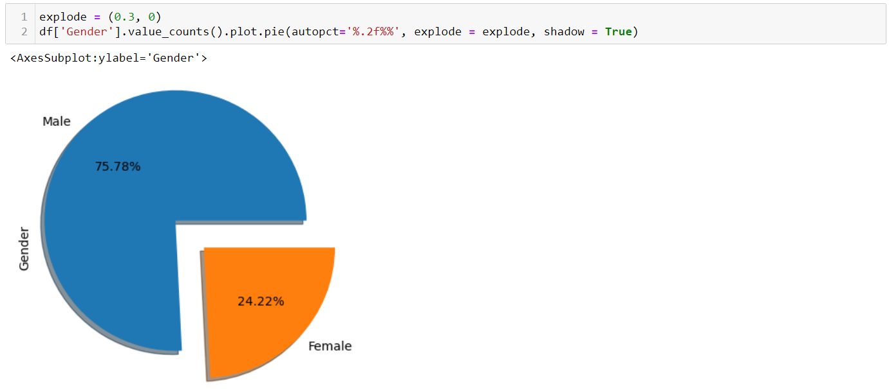
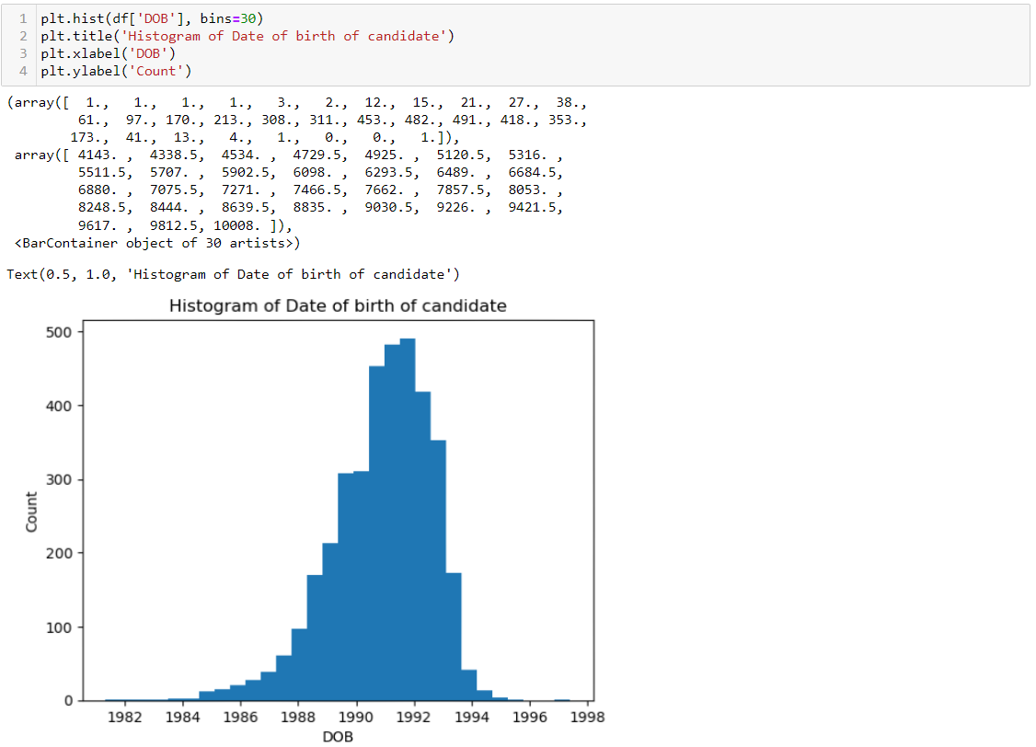
Observation : In the pie chart of Gender of candidates, we can observe that more of Male candidates are presented in AMCAT exam than Female candidates.
Observation : In the Histogram of DOB of candidates, we can observe that more of AMCAT exam 2015 born in 1991 year.

Slide 20
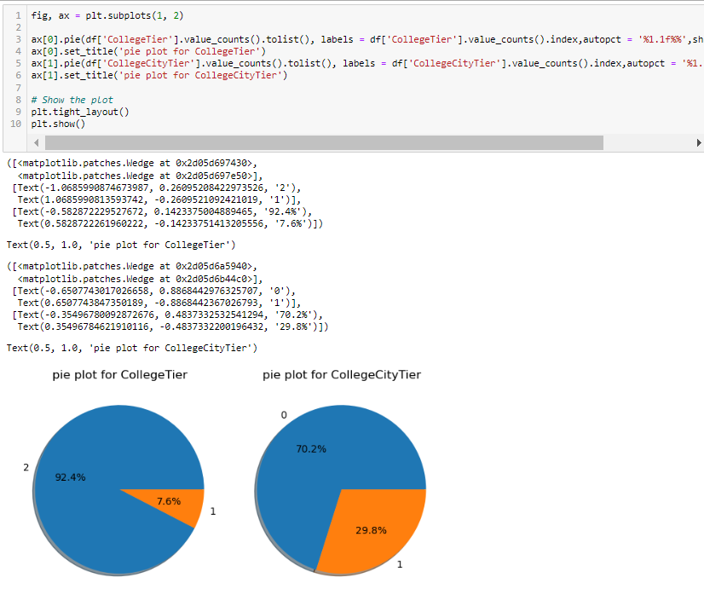
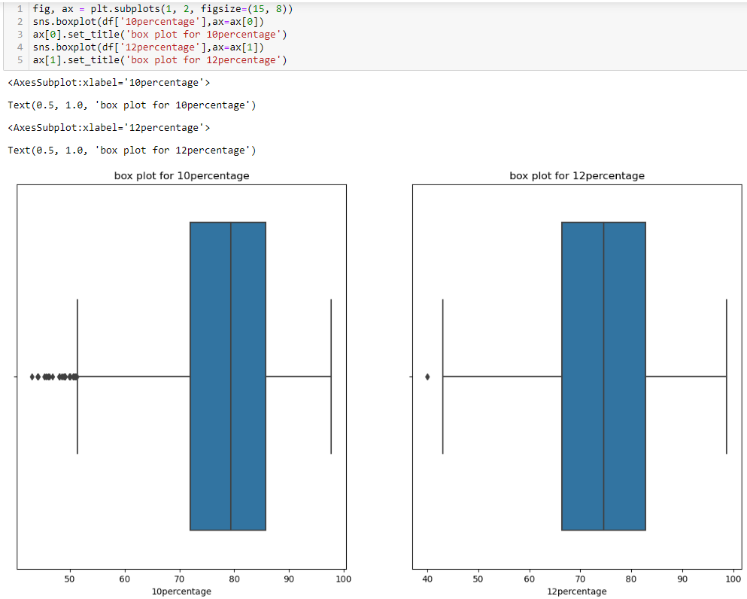
Observation : In the above pie charts of College Tier & College City Tier, Almost all the college belongs to Tier 1 only with 92.4% and Majority of the colleges are form Tier 0 city with 70.2% .
Observation : In the Box plots of 10percentage & 12percentage, more of candidates gain 65% to 90% nearly.

Slide 21
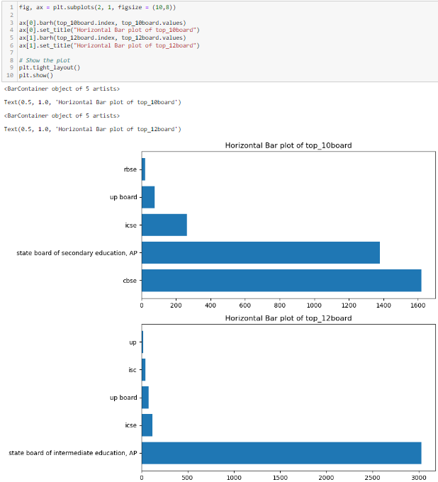
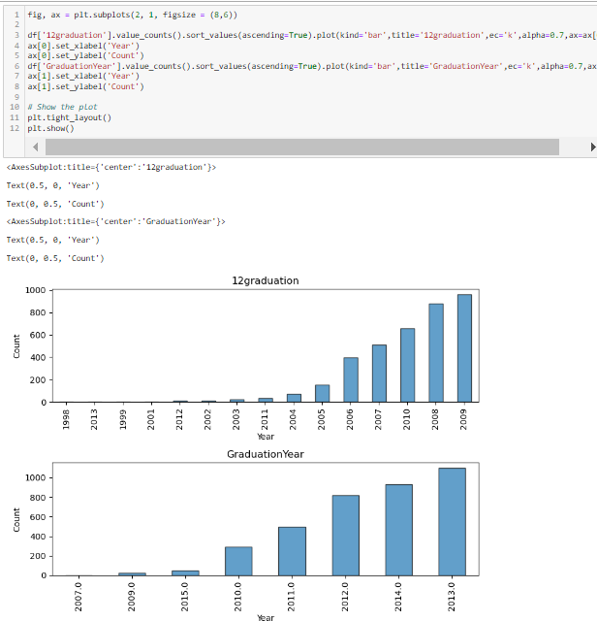
Observation : In the Horizontal bar plot of top_10board & top_12board, we can observe that ‘CBSE’ and ‘state board of intermediate education, AP’ are the more of candidates studied their 10th and intermediate(12th) respectively.
Observation : In the above bar plots of 12graduation & graduation year of degree , we can observe that more candidates were graduated in 2009 and 2013 respectively .

Slide 22
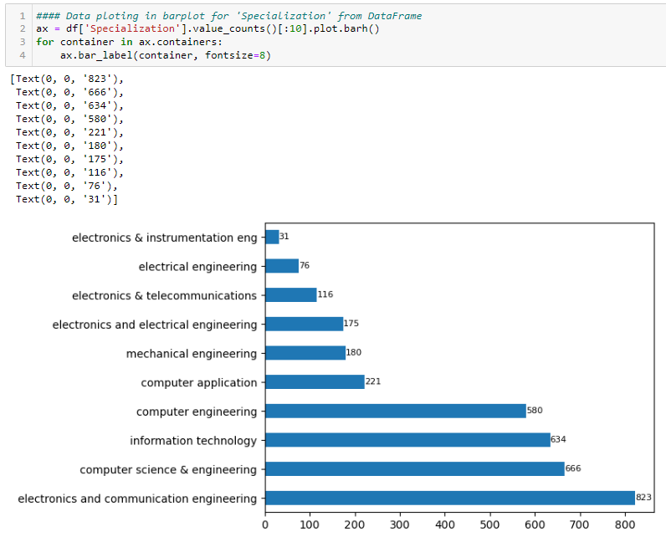
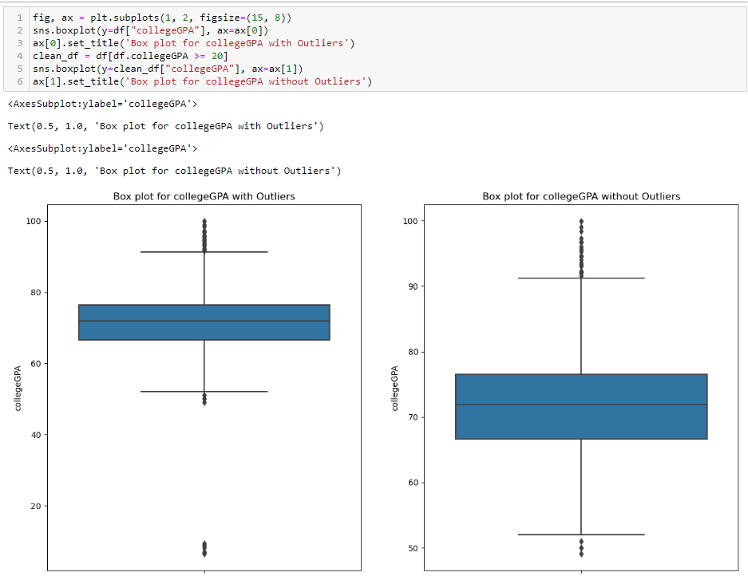
Observation : In the above horizontal bar plot of top-10 Specialization done by candidates, we can observe that ‘IT’ , ‘CSE’ and ‘ECE’ are highest in count respectively .
Observation : In the Box plot of candidates college GPA, we observed that more of whisk was present in middle of 60 to 80. It indicates that a majority of candidates got 60% to 80% nearly . We plot 2 plots for with outliers and without outliers.

Slide 23
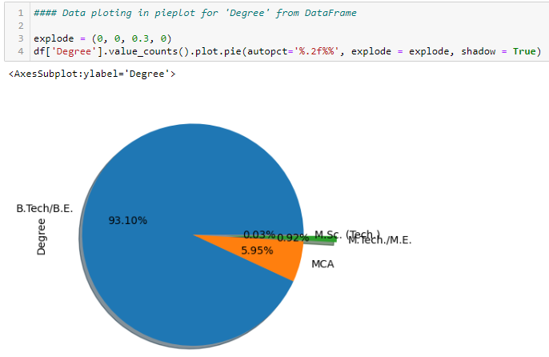
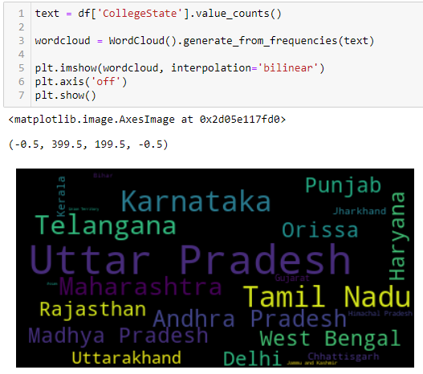
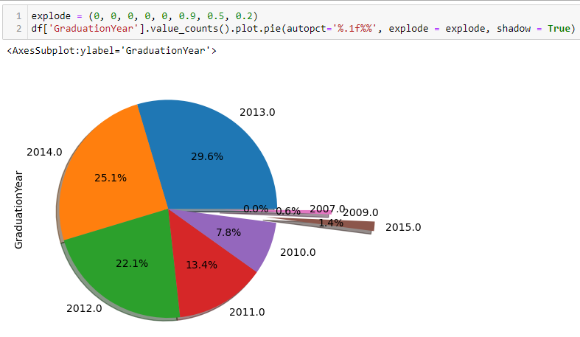
Observation : In the above pie chart of Degree, we can observe that 93.10% of candidates done their degree as ‘B.Tech/B.E’ .
Observation : In the above Word Cloud of Colle state , we can observe that most of candidates studied in ‘Uttar Pradesh’, ‘Karnataka’ and 'Tamil Nadu’ respectively .
Observation : In the above pie chart of Graduation year of candidates, we can observe that 2013, 2014 were most of candidates graduated respectively .

Slide 24
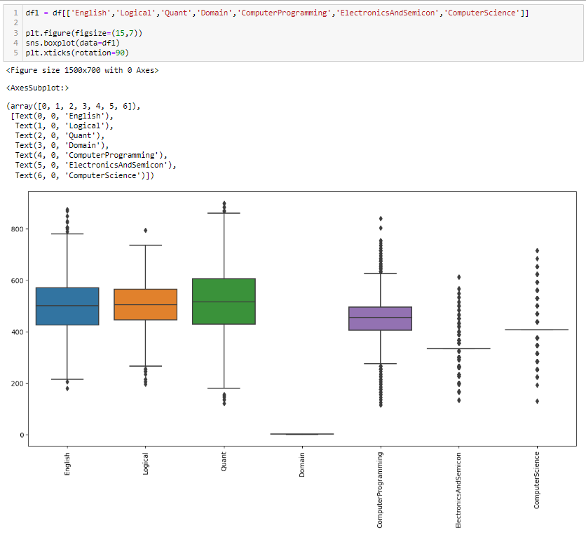
Observation : In the Box plots of candidates scores in several exams, we can observe that most of candidates got 400 to 600 marks in ‘English’ , ‘Logical’ , ‘Quant’ , ‘Computer Science’ & ‘Computer Programming’ . And, ‘Electronics And Semicon’ exam most of students got nearly 300 to 350 marks , in ‘Domain’ exam they got 0 to 1 .

Slide 25
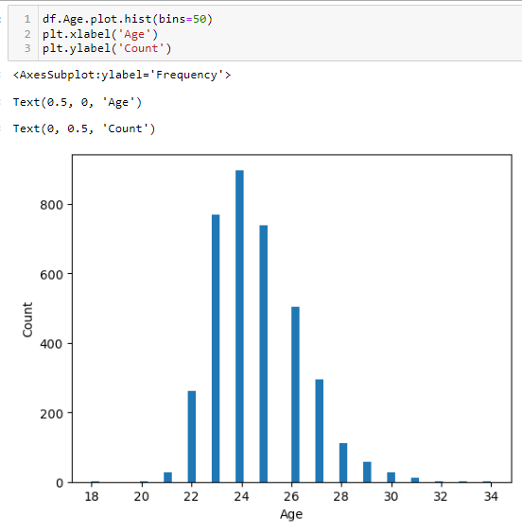
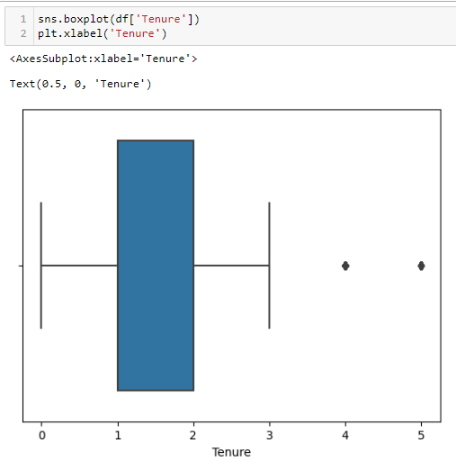
Observation : In the above histogram of Age of candidates, we can observe that most of candidates are 24 yrs old .
Observation : In the Box plot of candidates Tenure(Experience), we can observe that most of candidates got 1 to 2 yrs experience only .

Slide 26
- : Bivariate Analysis Steps : -
Accessing the dataset.
Identifying the target variable that needs to be analyzed by other variables.
To Analyze simultaneous examination of two variables to understand the relationships between them.
It often involves statistical tests such as t-tests or chi-square tests to determine the significance of observed relationships.
Through statistical tests, Enhancing the interpretability and reliability of the findings.

Slide 27
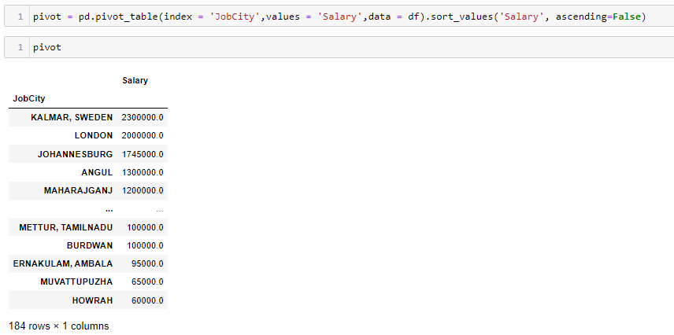
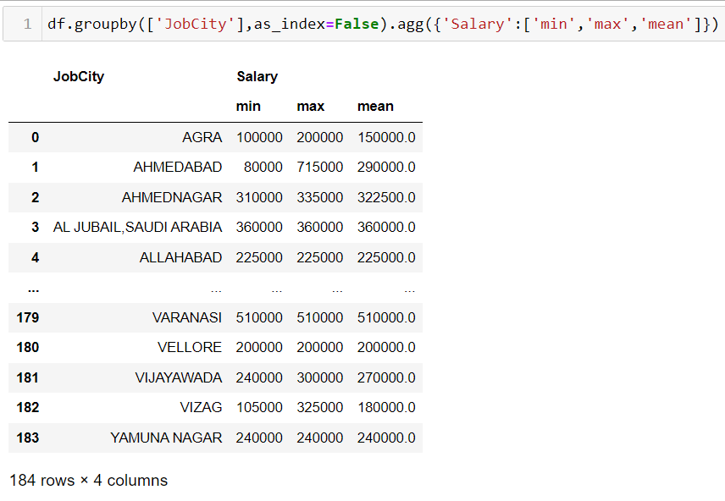
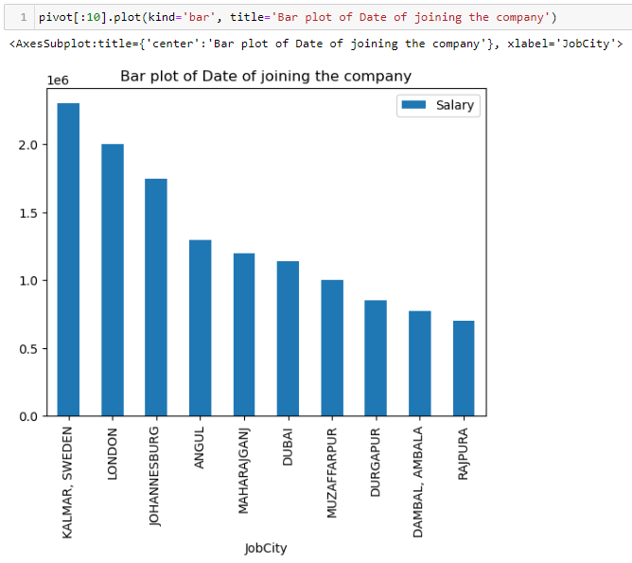
Observation : In the above bar plot of ‘Job city’ VS ‘Salary’ , we can observe that the candidates whom Job city as ‘Sweden’ are getting highest salary among all of the candidates .
Observation : In the above Groupby table, we use ‘Job city’, ‘Salary’ as index and values. Where we use min, max and mean as aggregation function .

Slide 28
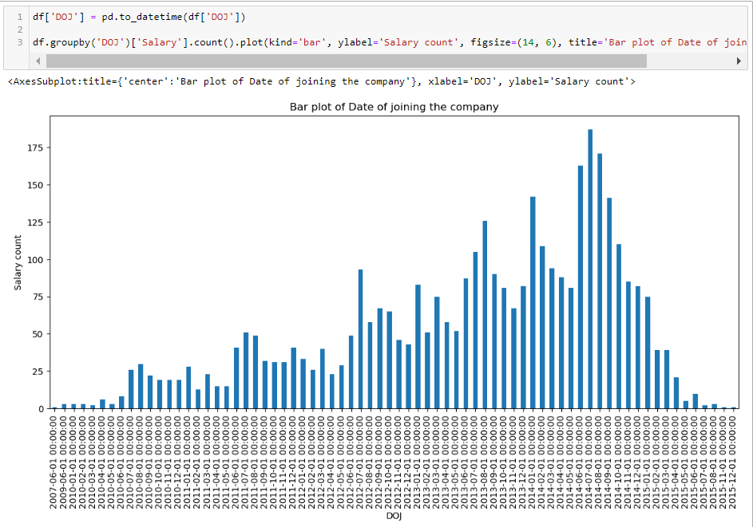
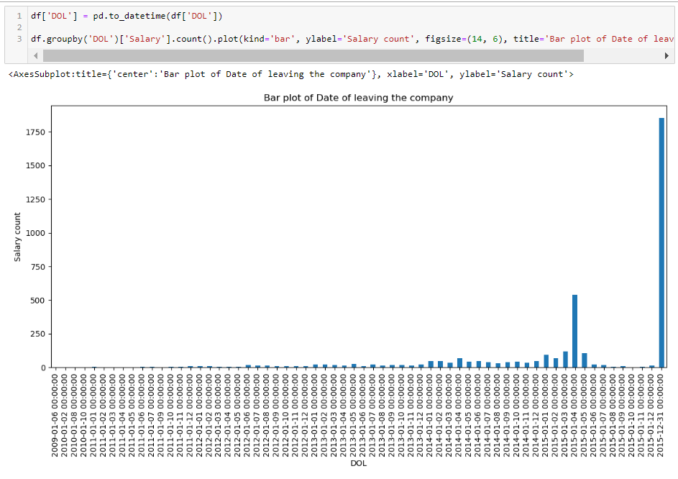
Observation : In the above bar plot of Groupby table of ‘DOJ’ , ‘Salary’ , we can observe that most of candidates who joined in 2014 were getting highest Salary .
Observation : In the above bar plot of Groupby table of ‘DOL’ , ‘Salary’ , we can observe that most of candidates who left in 2014 and 2015 were got highest Salary .

Slide 29
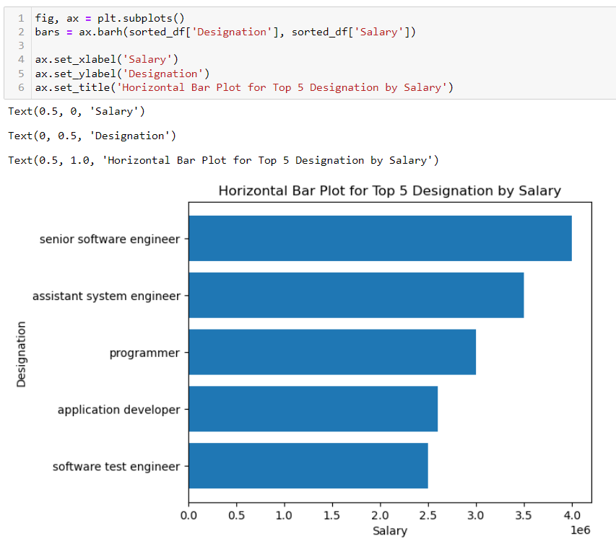
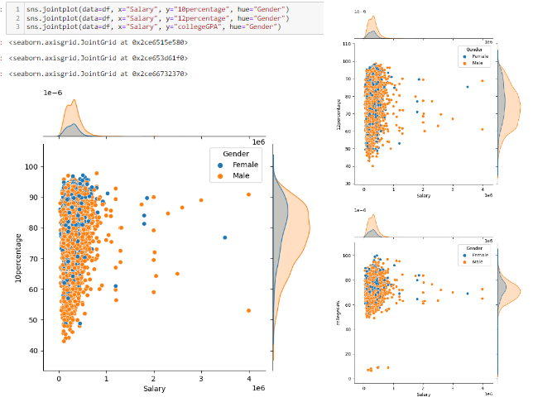
Observation : A clear trend in the dataset suggests that individuals with 10percentage, 12percentage and college GPAs falling within the 50-90% range tend to report higher salaries.
Observation : Senior Software Engineer getting highest salary i.e., nearly 4Lakhs and Assistant System Engineer is getting 2nd highest salary i.e., nearly 3.5Lakhs.

Slide 30
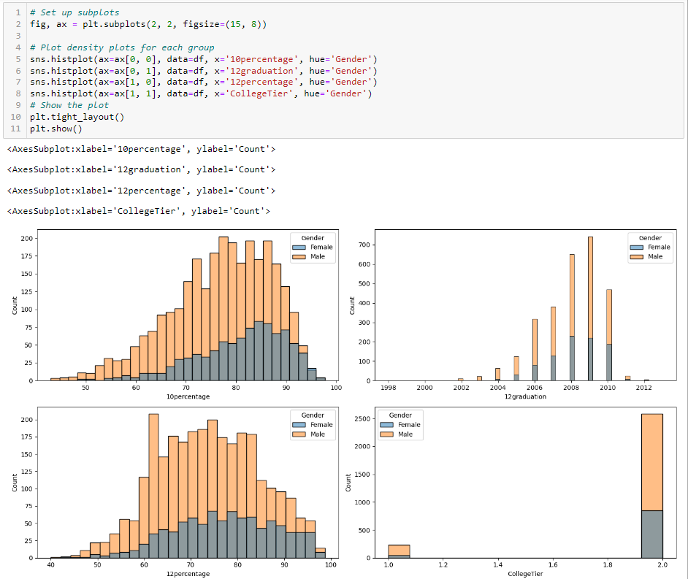
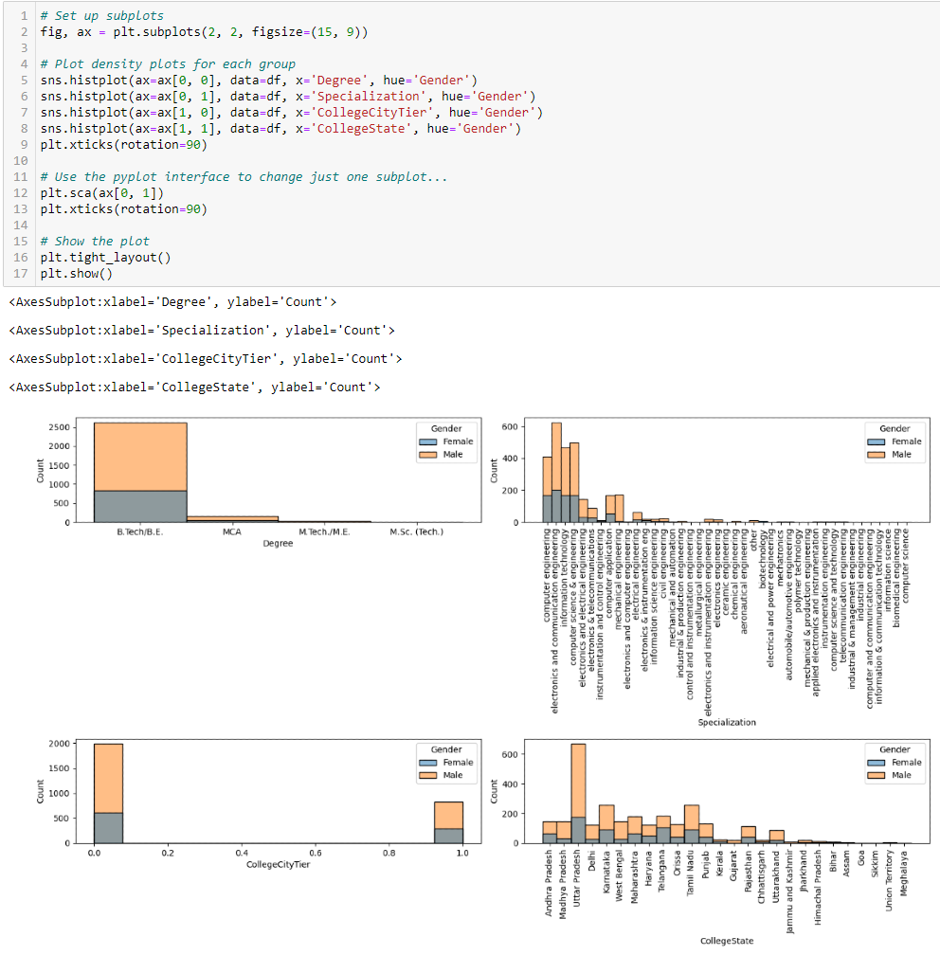
Observation : In the above histograms, we can observe that in all columns '10percentage’ , '12percentage’, '12graduation’ & 'College Tier’ most of the candidates are Male compare to Female .
Observation : In the above histograms, we can observe that in all columns ‘Degree’ , 'Specialization’, 'College City Tier’ & College State’ most of the candidates are Male compare to Female .

Slide 31
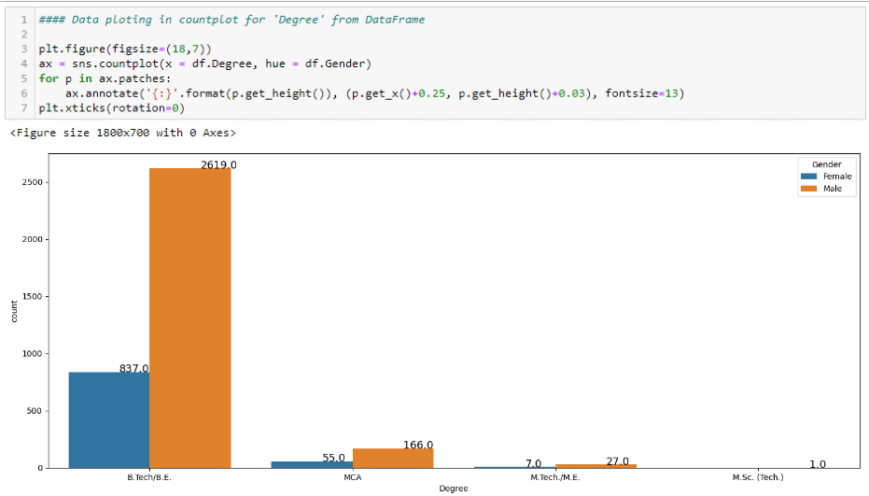
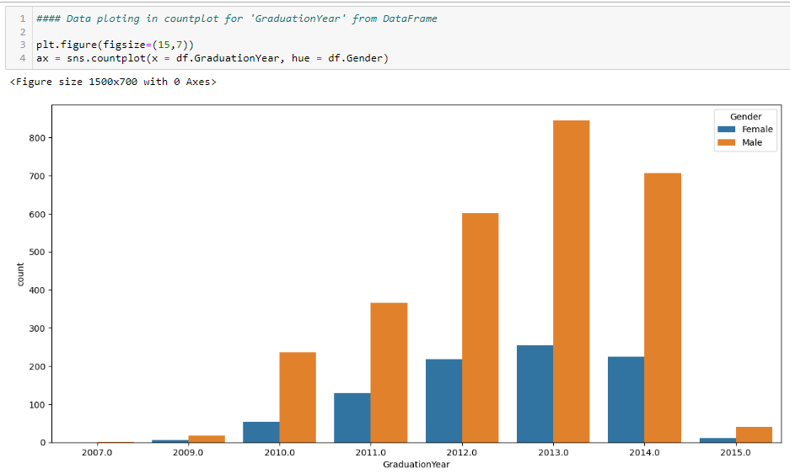
Observation :
In the count plot of candidates ‘Degree’ VS ‘Gender’ , we observed that in all Degree’s i.e., 'B.Tech/B.E.’ , 'MCA’ , 'M.Tech./M.E.’ and 'M.Sc. (Tech.)’ most of the candidates are Male compare to Female .
Observation :
In the count plot of candidates ‘Graduation year’ VS ‘Gender’ , we observed that in all years i.e., 2007 , 2009 , 2010 , 2011 , 2012 , 2013 and 2014 , 2015 most of the candidates are Male compare to Female .

Slide 32
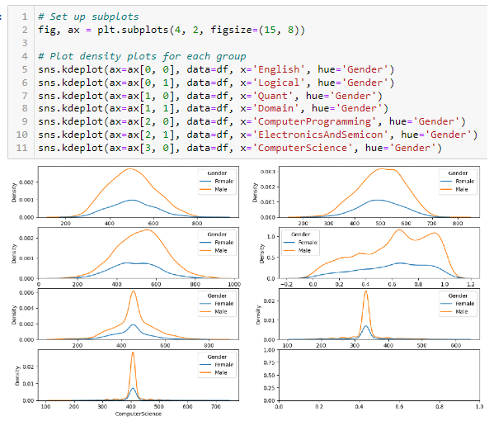
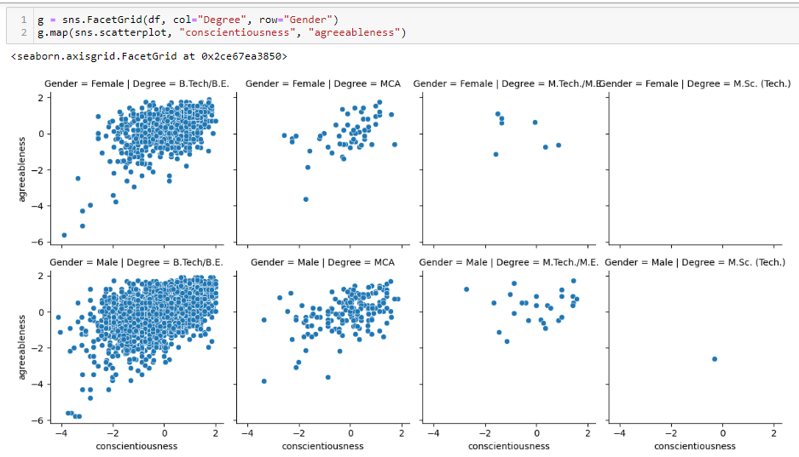
Observation : In the KDE plots of candidates exam scores with hue as ‘Gender’ , we observed that by peak of curve in all exams such as ‘English’ , ‘Logical’ , ‘Quant’ , ‘Domain’ , ‘Computer Programming’ , 'Electronics And Semicon’ & 'Computer Science' most of the candidates are Male compare to Female .
Observation : In the Facet grid using scatter plot for mapping of candidates few Scores in one of the sections of AMCAT’s personality test with ‘Gender’ as row & ‘Degree’ as column, we observed that in all exams such as ‘conscientiousness’ & 'agreeableness' most of the candidates are Male compare to Female who has ‘B.Tech/B.E’ & ‘MCA’ respectively .

Slide 33
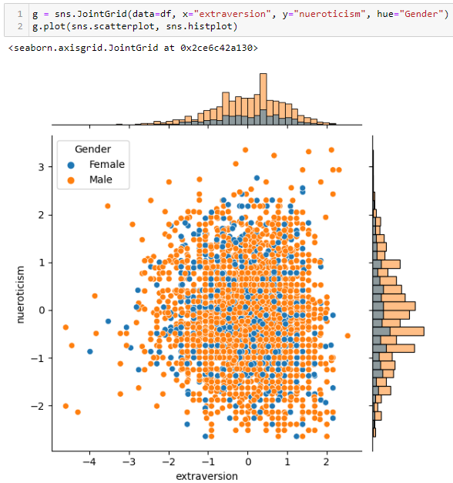
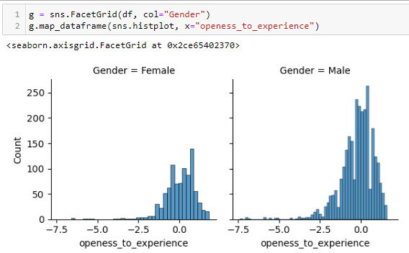
Observation : In the Joint Grid using scatter plot for mapping of candidates few Scores of the sections of AMCAT’s personality test with hue as ‘Gender’ , we observed that in few sections of personality test such as ‘extraversion’ & ‘Nueroticism' most of the candidates are Male compare to Female .
Observation : In the Facet grid using histogram for mapping of candidates Scores of one of the sections of AMCAT’s personality test ‘openess_to_experience’ with column as ‘Gender’ , we observed that most of the candidates are Male compare to Female .

Slide 34
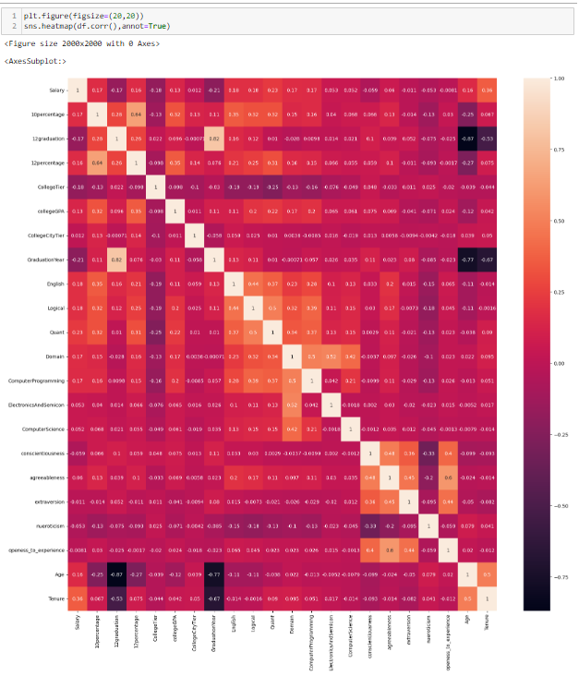
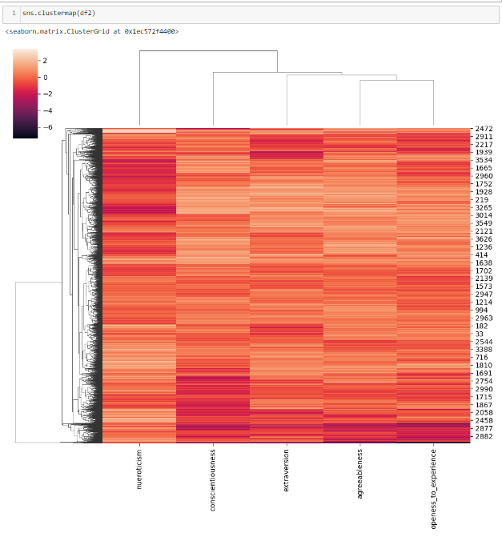
Observation : In the clustermap, Plot a matrix using hierarchical clustering to arrange the rows and columns. We took Scores of the sections of AMCAT’s personality test as new dataframe, we plot for that 5 sections of AMCAT’s personality test in clustering.
Observation : In the Heatmap, Plot rectangular data as a color-encoded matrix from given dataset.

Slide 35
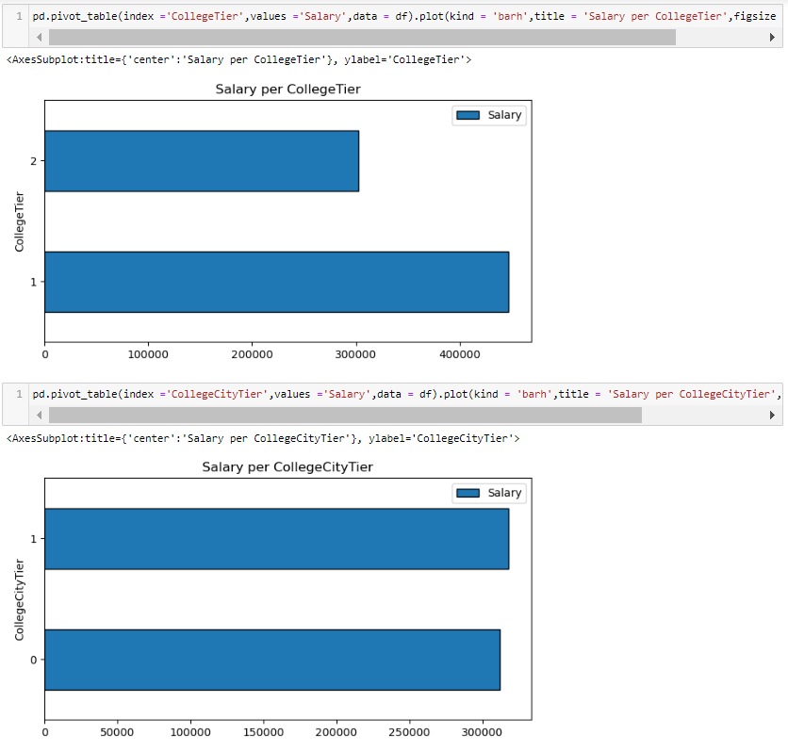
Observation : College within Tier 1 offers high salary as compared to the colleges in Tier 2. Colleges in Tier 2 offers below overall average salary.
Observation : Cities under Tier 1 and 2 offers almost same salaries to student.

Slide 36
Research Questions

Slide 37
- : Research Question Steps: -
Develop your hypothesis:
a) Null hypothesis (what you want to reject).
b) Alternative hypothesis.
Collect your data.
Calculate test statistic.

Slide 38

- : Research Question 1: -
Claim 1 : - Times of India article dated Jan 18, 2019 states that “After doing your Computer Science Engineering if you take up jobs as a Programming Analyst, Software Engineer, Hardware Engineer and Associate Engineer you can earn up to 2.5-3 lakhs as a fresh graduate.” Test this claim with the data given to you..|

Slide 39
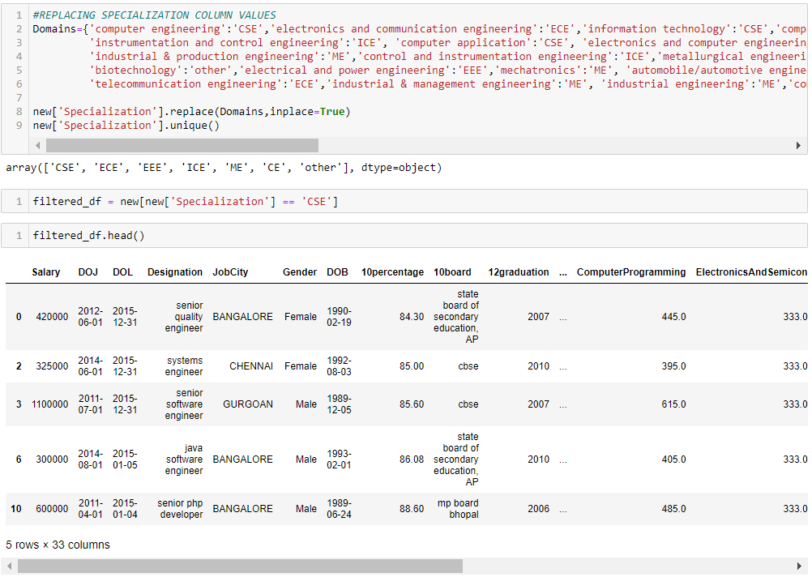
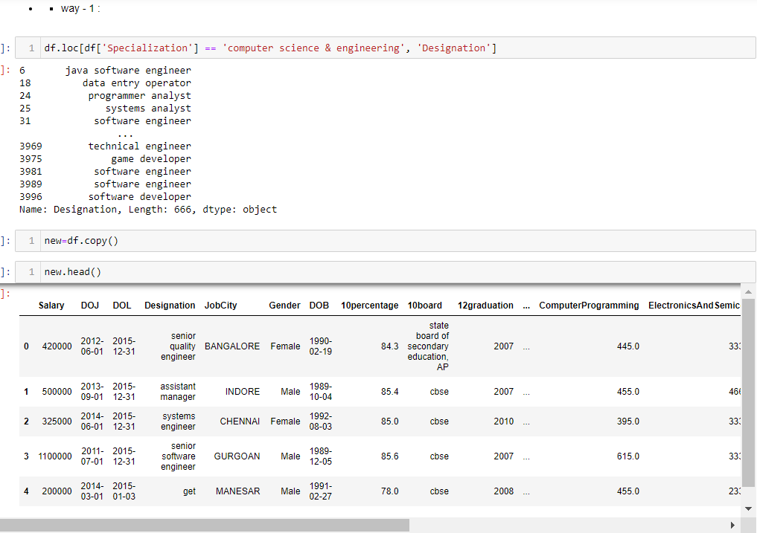
Way – 1 :-

Slide 40
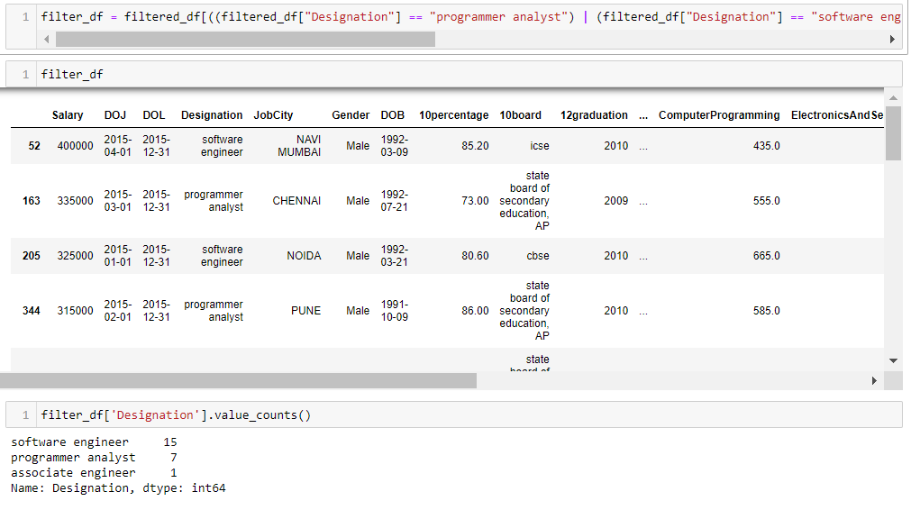
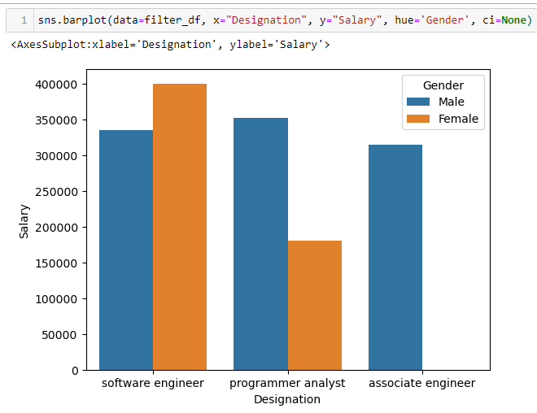
Observation :
For Freshers, the salary is starting from 300k and male are earing more than female as a fresher.

Slide 41
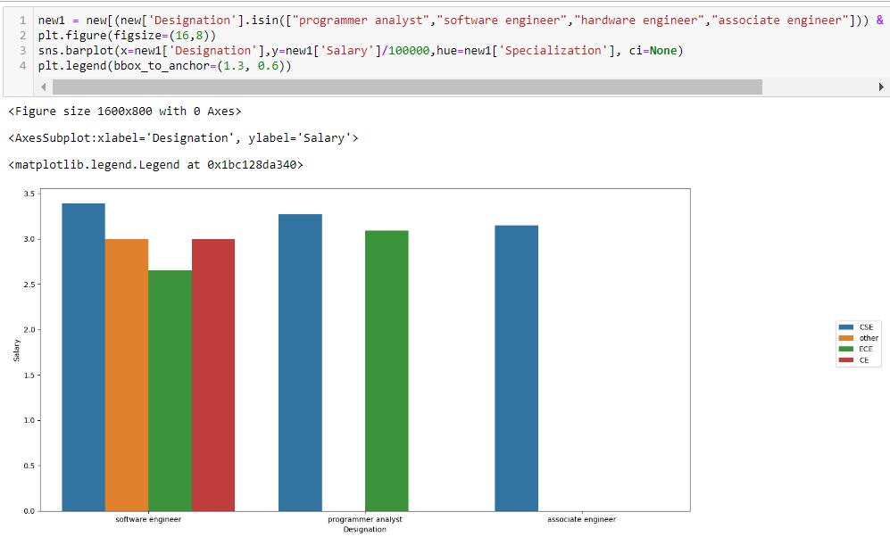
Way – 2 :-
Observation : From the plot, it is evident that Programming Analysts, Software Engineers, Hardware Engineers and Associate Engineers can earn up to 2.5–3 lakhs as a fresh graduate.

Slide 42
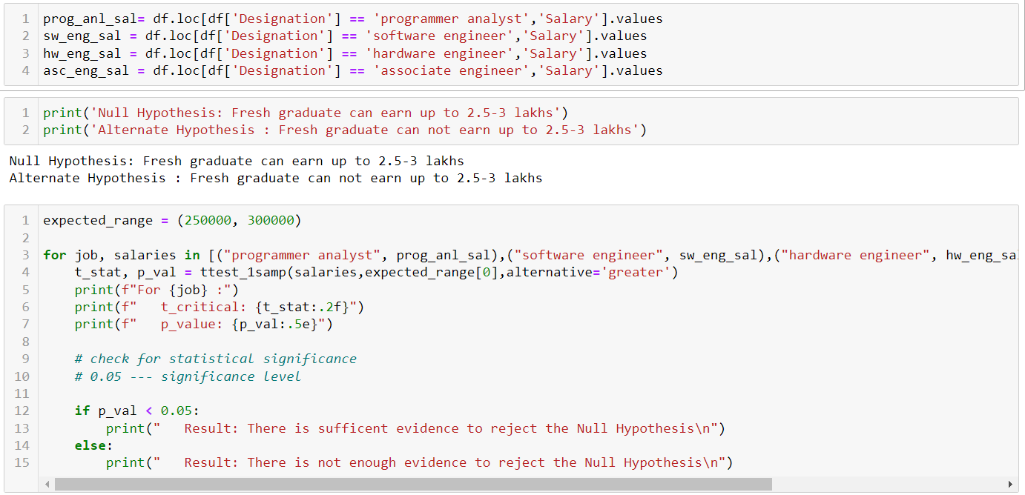
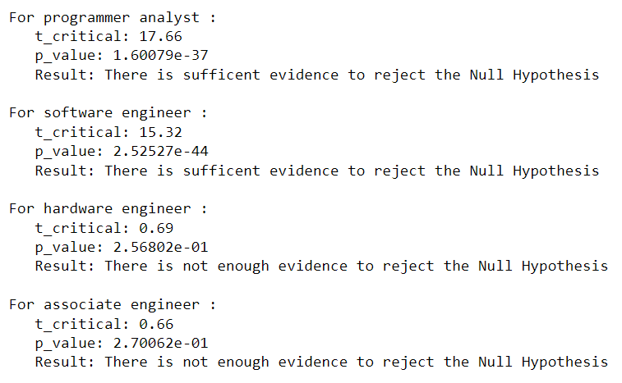
Way – 3 :-
Observation :
A one-sample t-test is conducted for each job designation to compare their average salary against an expected range. For Programmer Analysts and Software Engineers, the test results show sufficient evidence to reject the null hypothesis, suggesting that their salaries significantly differ from the expected range. However, for Hardware Engineers and Associate Engineers, there is not enough evidence to reject the null hypothesis, indicating that their salaries may not significantly deviate from the expected range.

Slide 43
- : Research Question 2: -
Rsearch Question 2 : -
Is there a relationship between gender and specialization? (i.e. Does the preference of Specialization depend on the Gender?)..|

Slide 44
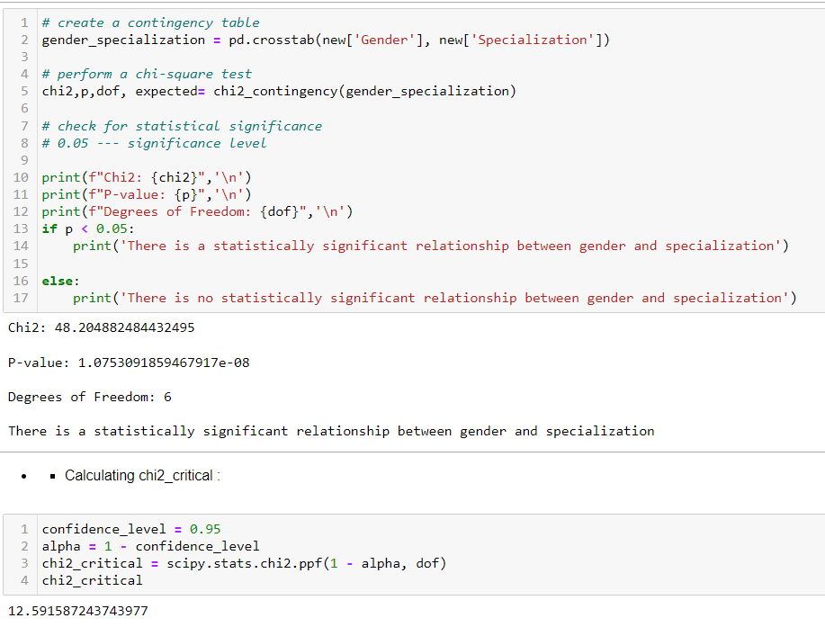
Observation :
• As the result of the second research question, we can see that there is a relationship between Gender and specialization.
• We test this claim through Chi-Square test and find the result that both the categorical variables are dependent on each other.

Slide 45
Conclusion :
The following conclusions were made from the analysis of the data:
Most of the aspirants are male from CS and EE department from Tier-1 Colleges and they work in IT domain, mostly in Mumbai and Bangalore cities with an average salary of 3LPA and maximum salary of 40LPA.
Most of the female aspirants prefer CS, EE, IT departments rather than mechanical, civil and they also prefer to work in IT domain mostly in Mumbai, Pune cities with an average salary of 2.9LPA and maximum salary around 36–37 LPA.
Bangalore is most sought out place for working but most of the students from Tier-1 college work in Greater Noida.
Software Engineer and Software developer are the most popular roles among the aspirants whereas senior software engineer and assistant manager roles have the highest salary package.

Slide 46
Key Business Questions :
What business critical problems do you solve for your customers?
What are the most important features and capabilities of your solution?
What are the key metrics you use to manage the business?
What are your prospect’s alternative options?

Slide 47
- : Bonus Question (Research Question ) : -
Bonus Question : -
If the candidate has higher Education, it leads to better Salary. Test this claim with the data given to you..|

Slide 48

Claim : Higher Education leads to better wages.
Observation :
• As the result of the Bonus question, we can see that there is no difference in Salaries between under-graduates & post-graduates.
• We test this claim through t-test and find the result that, Salary is not depend on Degree(Under-Graduate & Post-Graduate).

Slide 49


Thank You

